Slide 1
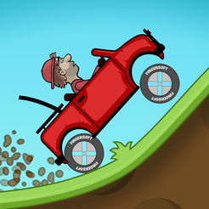
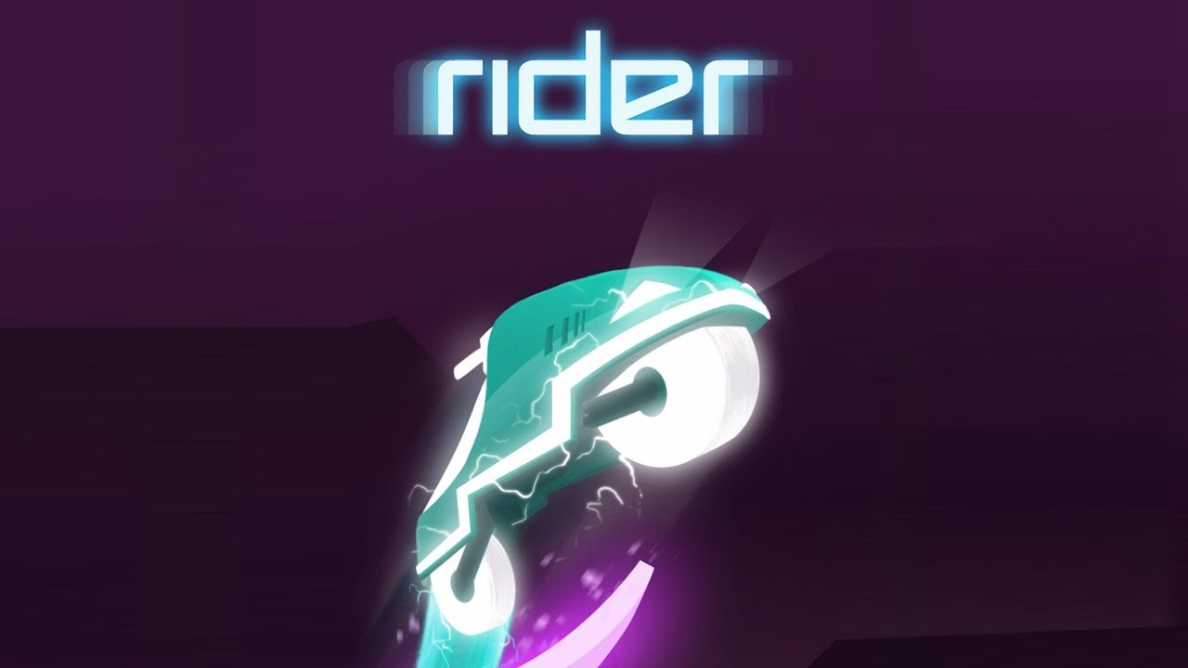
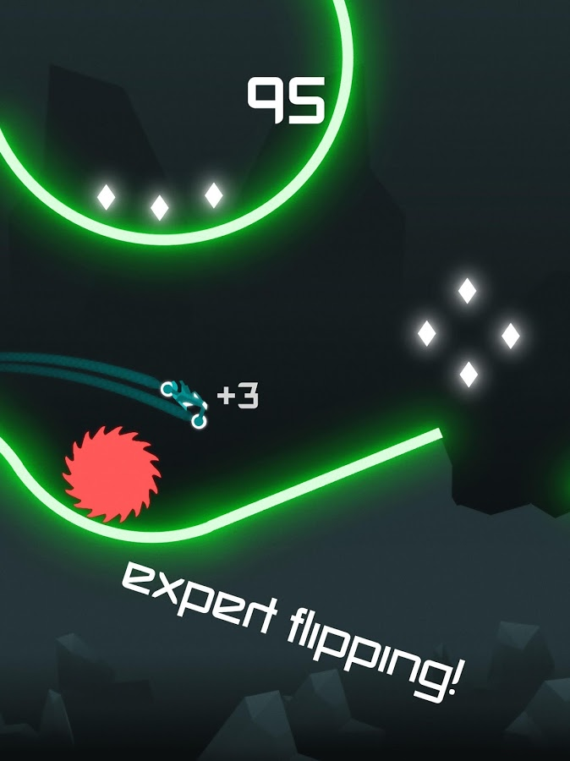
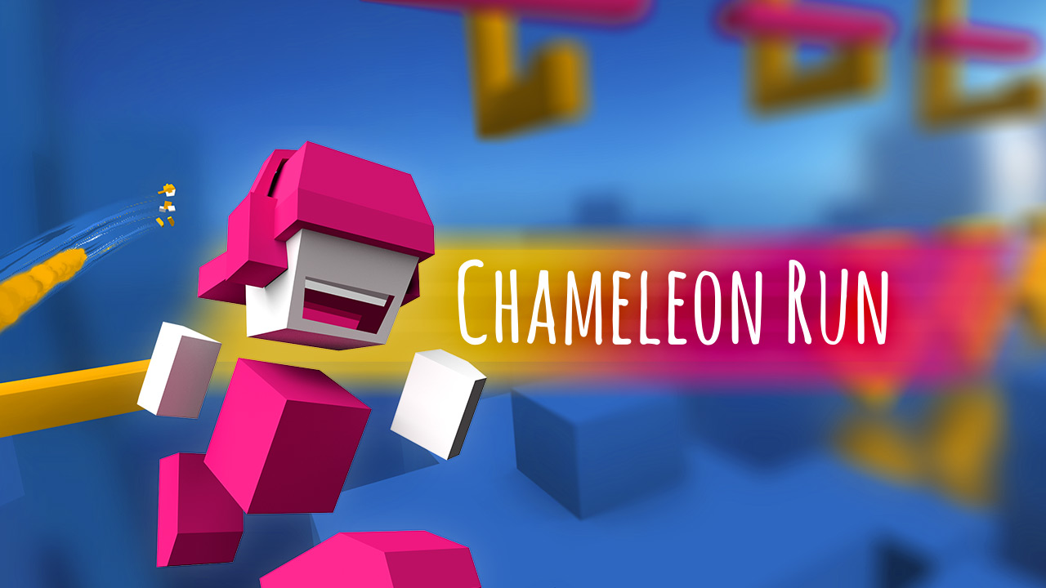
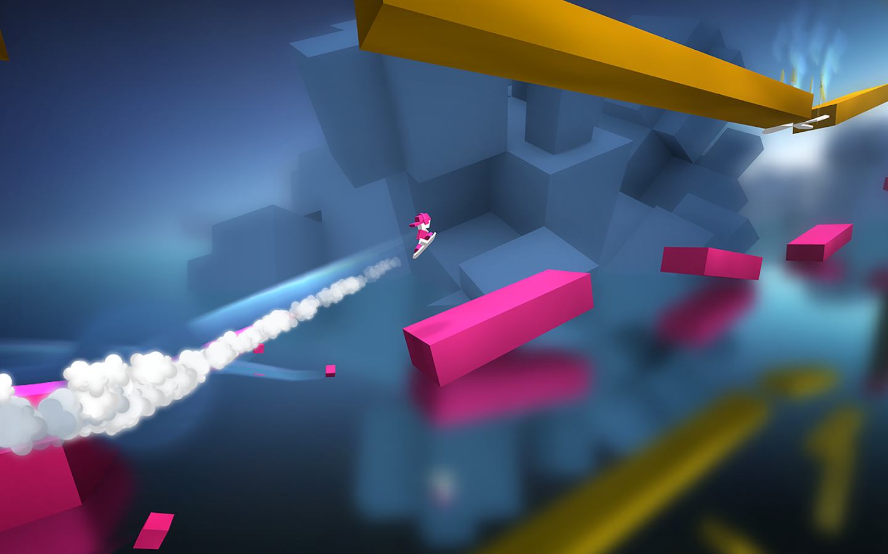
Game Idea
Hill Climb Racing Rider Chameleon Run
Players take it in turn to get the furthest distance
People drive by pressing the space button
The map will have bumps etc, so the player has the judge the speed
There could be boosts and pick-ups that could cut your time, or add time onto the players

